Slide 1
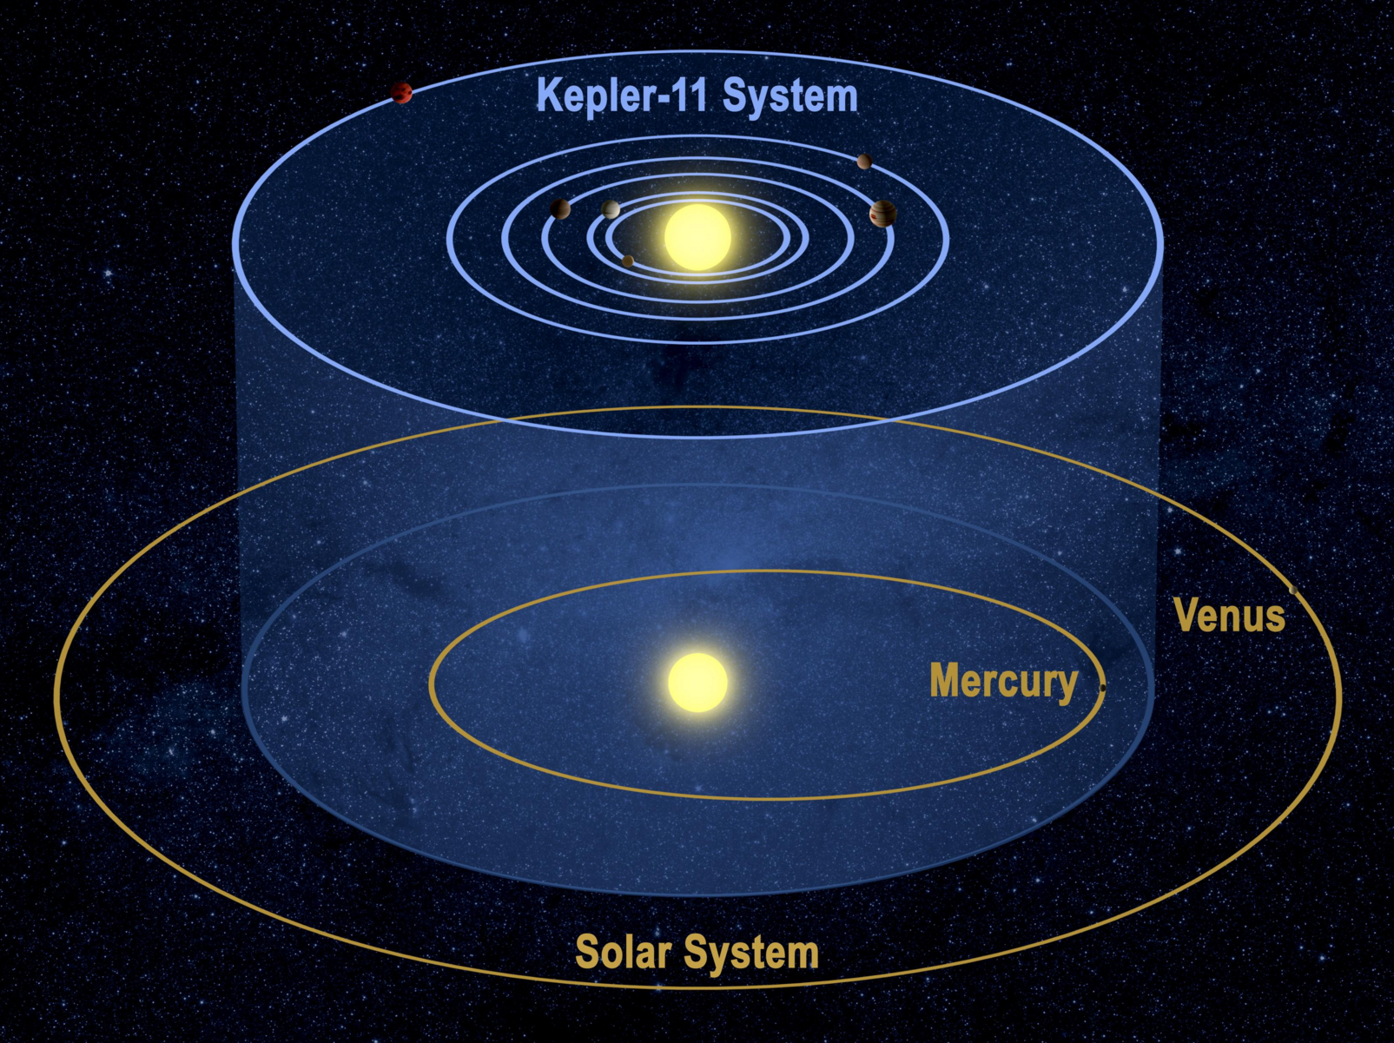
Are Planetary Systems Stable?

Slide 2
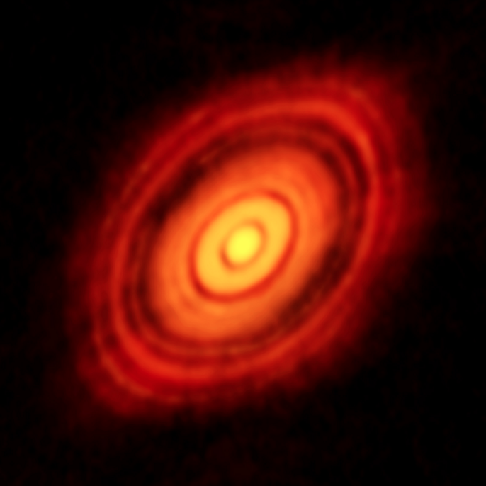
A Way to Constrain Masses

Slide 3
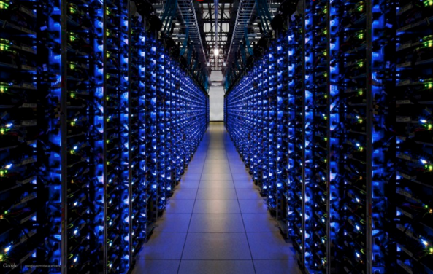
A Computational Bottleneck

Slide 4
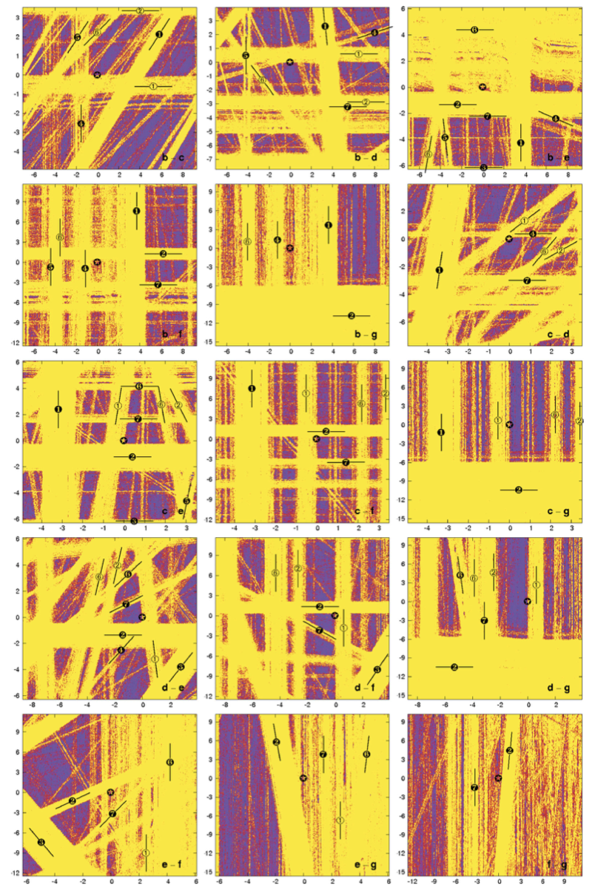
Chaos
Notes:
660 million core hours

Slide 5
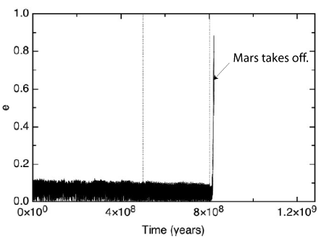
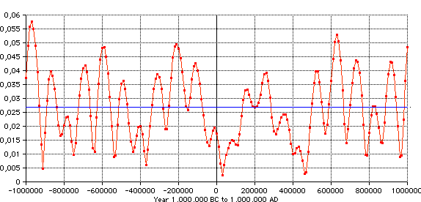
Can Machine Learning Help?

Slide 6
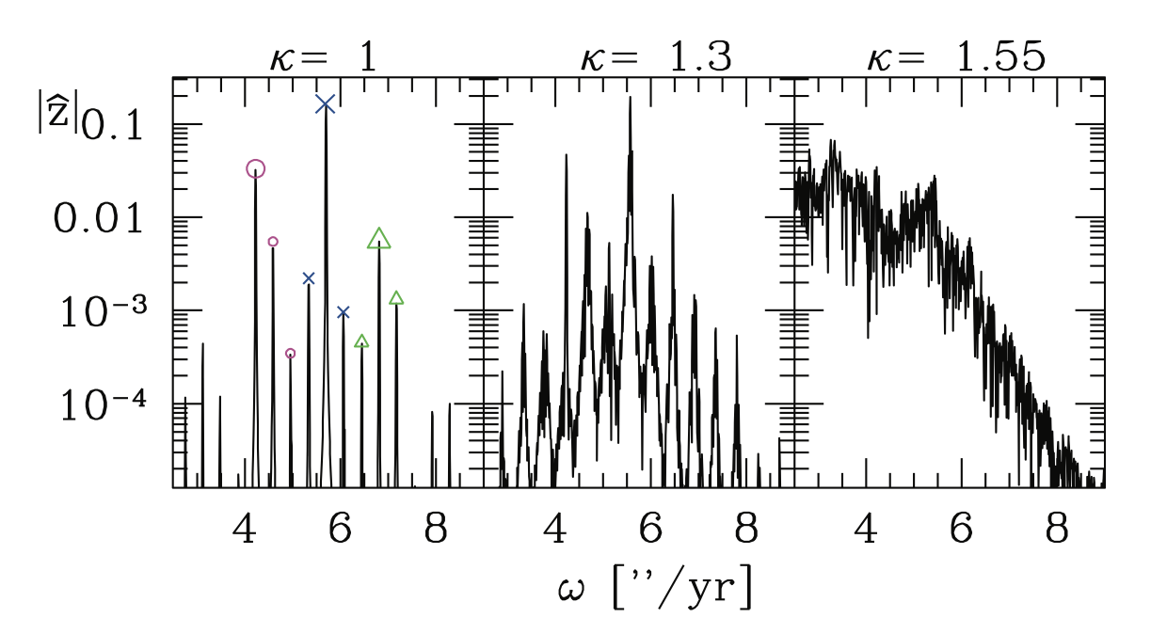
A Wealth of Information

Slide 7
Let’s Train a Planetary Stability Classifier!

